Slide 1
Proposed Operating Budget
FY 2025

Slide 2
Overview
Fiscal Year ‘25 is the first year of the State Budget Biennium and revenue numbers are reflective of the current funding level provided by the DOE. The FY ‘25 State Budget was presented with the first step of the increase in compensation for teachers and staff in order to better align our scales with our partner districts.
We are proposing a budget increase that reflects the increased costs of goods and services to address the needs of the school and to continue to fund capital projects.

Slide 3
Revenue

Slide 4
Revenue Overview
Fiscal Year | Amount
FY ‘24 | $10,589,799
FY ’25 | $11,895,952
Total Increase:
$1,306,153 (12.33%)

Slide 5
Revenue Detail
Description | Amount
Local Contribution: 797 students x $10,200 | $8,129,400
Building Rental | $7,000
Salary Supplement Incentive | $12,500
Dual Enrollment | $30,000
Technology Initiative | $26,000
Building Reserve and Carryover State Contribution | $200,000 $3,491,052
Total FY ‘25:
$11,895,952

Slide 6
Expenses

Slide 7
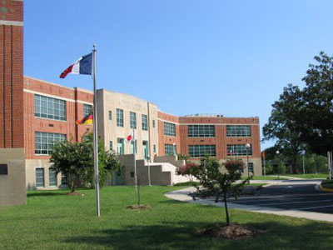
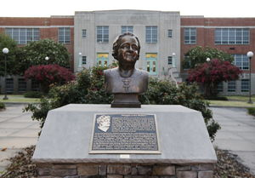
Expenses Overview
FY ‘25:
$11,895,952

Slide 8
Major Expense Detail-Additions
Description | Amount
Administration Fees (Altria and Convenience Fee for Online Payments) | $25,000
Salary/Benefits | $892,333 (Provides an additional 2.0 FTE for growth)
Utilities | $101,000
Maintenance and Repair | $180,000 (Replace 2 RTUs)
Service Contracts | $24,700
Health Insurance | $93,000
Textbooks | $66,633
Total Additions: $1,306,153*
*And incremental increases for inflation in certain areas

Slide 9
Major Expense Detail-Reductions
Description | Amount
Non-Contractual Leave Payout | $13,000
Worldwide Liability | $20,680
Additional Buses | $25,000
Total Reductions: $58,680

Slide 10
Conclusion

Slide 11
Thoughts Going Forward
Funding outlook for FY’26
Need to continue de-compress salary scale
Need to find a way to fund capital improvement separately from general operating budget
Funding from the Commonwealth expected to be somewhat static for FY’26

Slide 12
Next Steps
February 15- March 21 – Public Comment Period
March 21- Request for Budget Approval

